Slide 1


National Institute of Technology, Warangal
Department of Electronics and Communication Engineering
ZOO MANAGEMENT DATABASE
MEET POPAT – 204157

Slide 2




Problem Statement
◆ To help for conservation of the Wildlife and to raise awareness amongst the future generation about the preservation of fauna, create a database for zoos. This database has information about animals present in zoo, employees who work and take care of animals at the zoo. Also, the databases has information about the visitors who visit zoo.

Slide 3
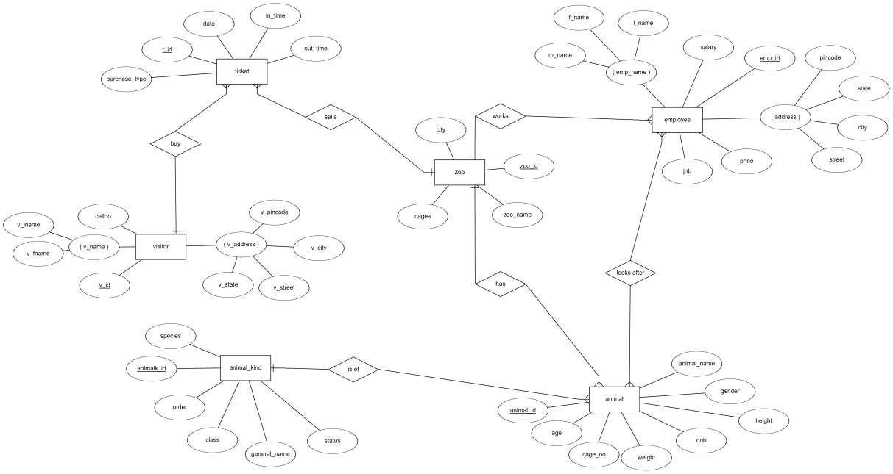

Slide 4
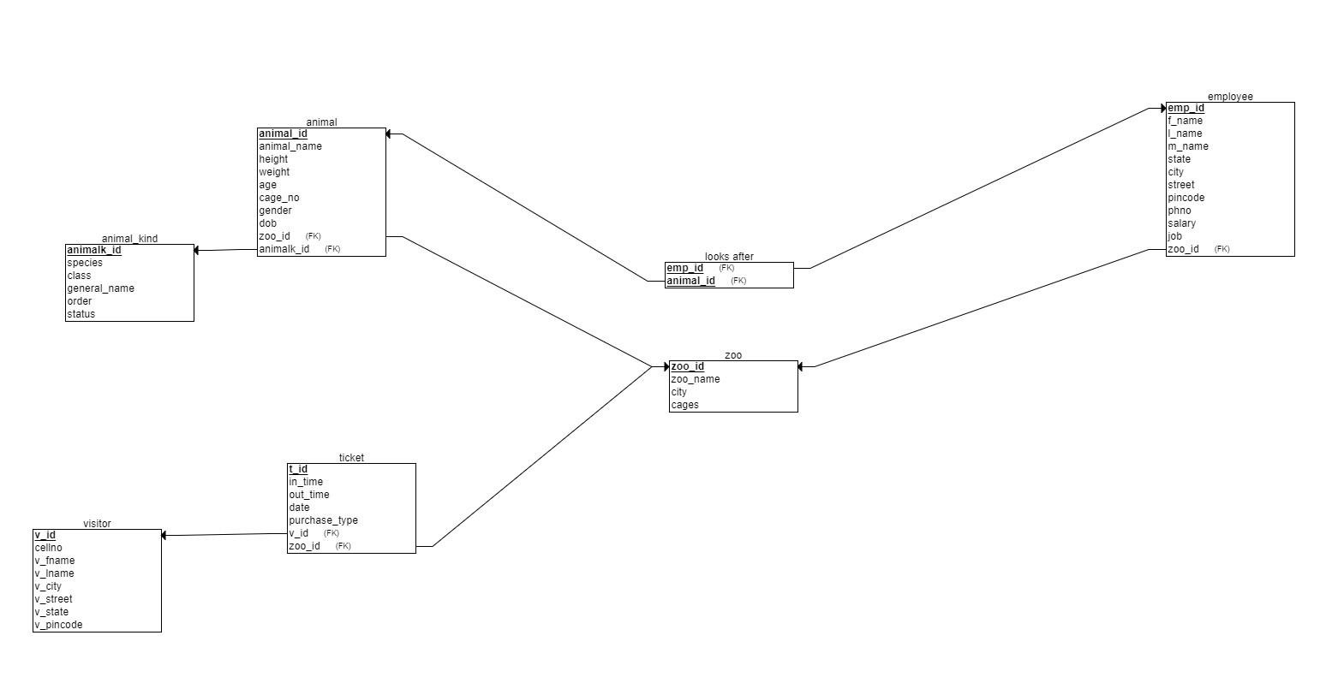

Slide 5

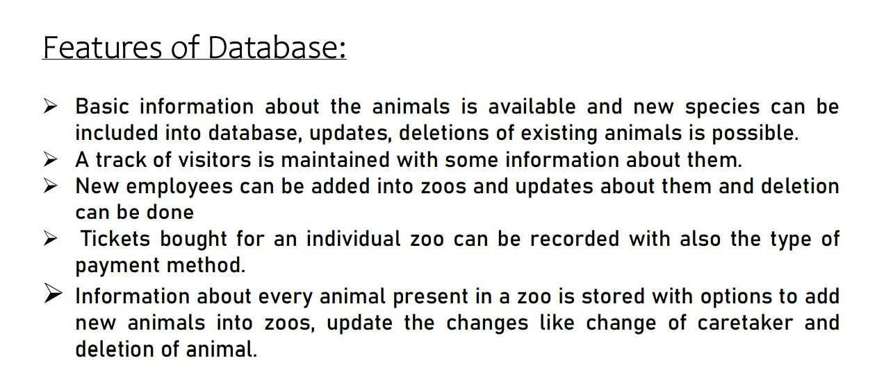
Features Of Database :

Slide 6
Normalisation

Slide 7
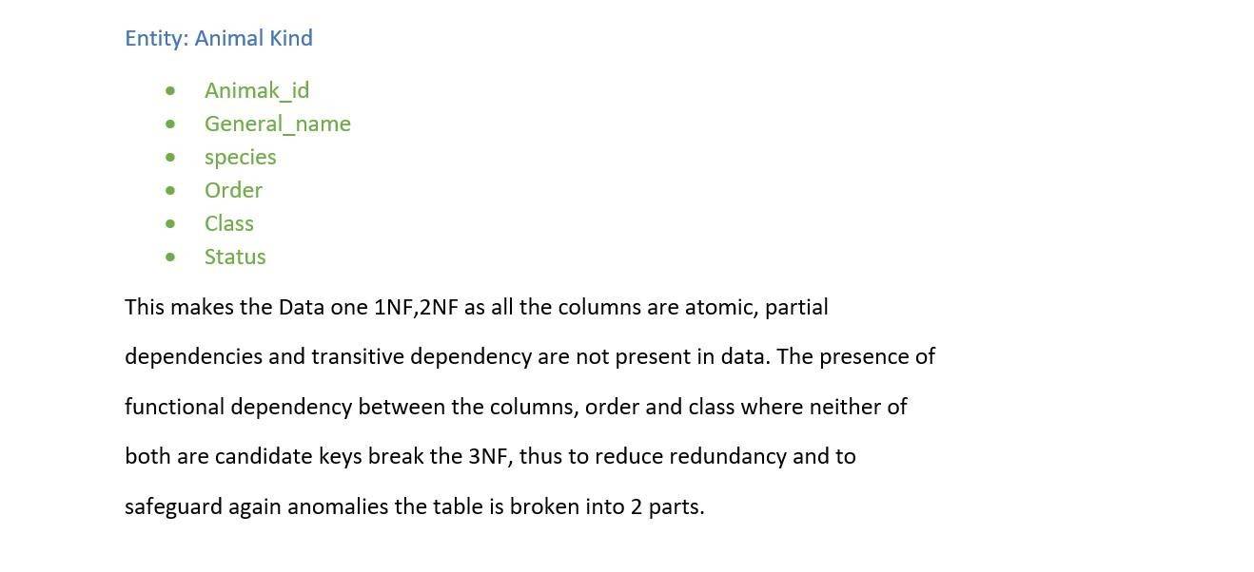

Slide 8
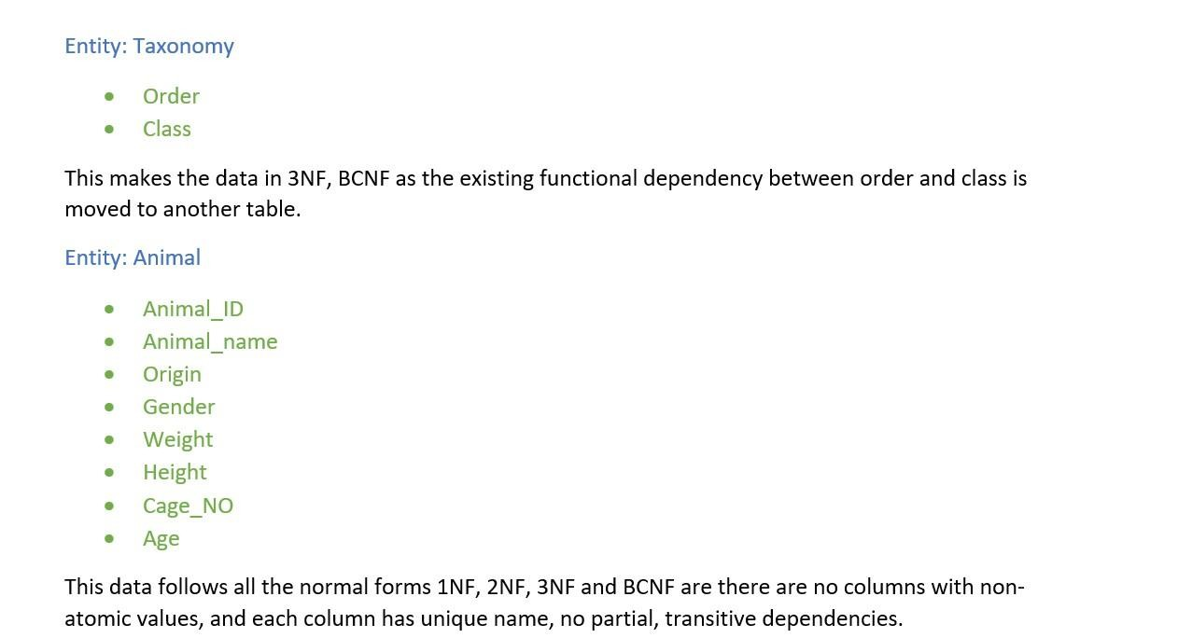

Slide 9
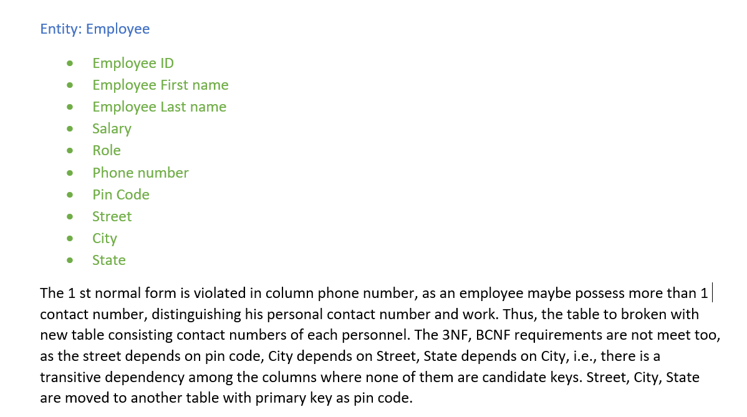

Slide 10
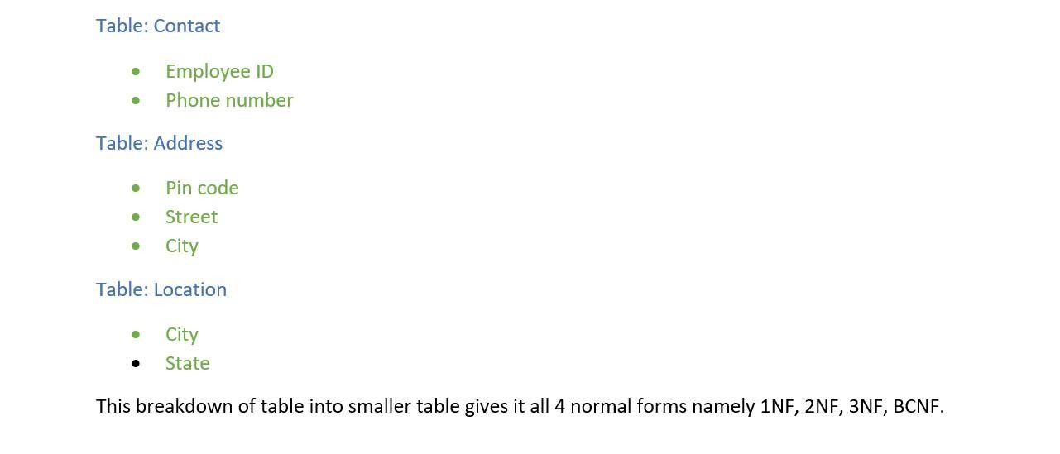

Slide 11
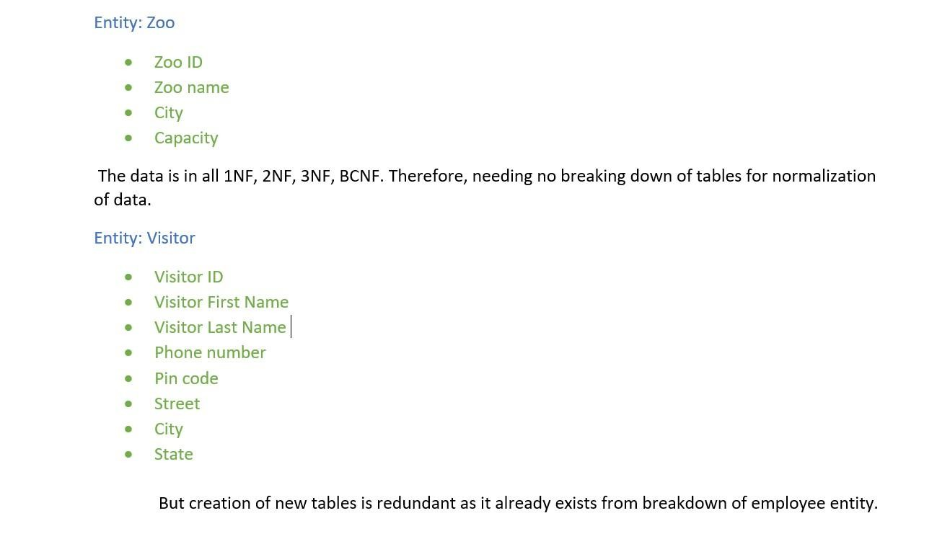

Slide 12
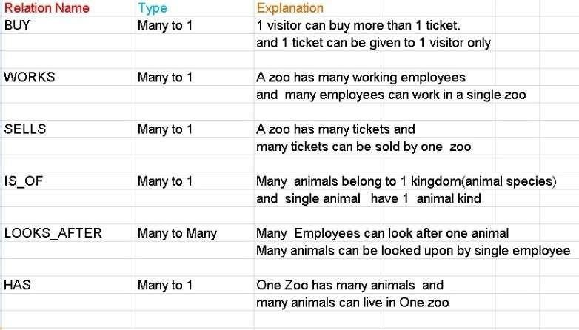

Slide 13
R e l a t i o n a l schema a f t e r n o rmal i s at i o n

Slide 14
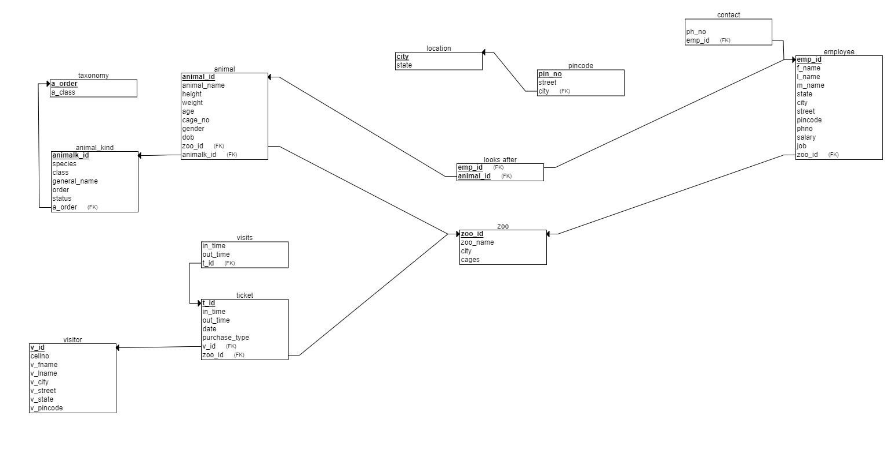

Slide 15
Creation o f t a b l e s
and insertion o f d a t a

Slide 16
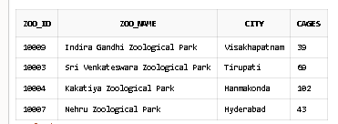
create table zoo (
zoo_id number primary key, zoo_name varchar(100), city varchar(100),
cages number
);
INSERT INTO zoo VALUES (10003, 'Sri Venkateswara Zoological Park', 'Tirupati', 69); INSERT INTO zoo VALUES (10004, 'Kakatiya Zoological Park', 'Hanmakonda', 102); INSERT INTO zoo VALUES (10007, 'Nehru Zoological Park', 'Hyderabad', 43);
INSERT INTO zoo VALUES (10009, 'Indira Gandhi Zoological Park', 'Visakhapatnam',39);

Slide 17
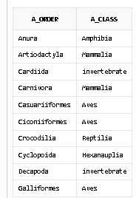
create table taxonomy(
a_order varchar(100) primary key, a_class varchar(100)
);
INSERT INTO taxonomy VALUES ('Anura', 'Amphibia’); INSERT INTO taxonomy VALUES ('Artiodactyla', 'Mammalia’); INSERT INTO taxonomy VALUES ('Cardiida', 'invertebrate’);
INSERT INTO taxonomy VALUES ('Carnivora', 'Mammalia’); INSERT INTO taxonomy VALUES ('Casuariiformes', 'Aves’); INSERT INTO taxonomy VALUES ('Ciconiiformes', 'Aves’); INSERT INTO taxonomy VALUES ('Crocodilia', 'Reptilia’); INSERT INTO taxonomy VALUES ('Cyclopoida', 'Hexanauplia’); INSERT INTO taxonomy VALUES ('Decapoda', 'invertebrate’); INSERT INTO taxonomy VALUES ('Galliformes', 'Aves’);

Slide 18
create table animal_kind (
animalk_id NUMBER primary key, general_name varchar(100), species varchar(100),
a_order varchar(100),
foreign key(a_order) references taxonomy(a_order), status varchar(10)
);
INSERT INTO animal_kind VALUES (105001, 'Bengal Tiger', 'Panthera tigris tigris', 'Carnivora', 'EN’); INSERT INTO animal_kind VALUES (105002, 'African Lion', 'Panthera leo leo', 'Carnivora', 'VU’); INSERT INTO animal_kind VALUES (105003, 'Chimpanzee', 'Pan troglodytes', 'primate', 'EN’); INSERT INTO animal_kind VALUES (106001, 'King Cobra', 'Ophiophagus hannah', 'serpentes', 'VU’);
INSERT INTO animal_kind VALUES (102001, 'Openbill Stork', 'Anastomus oscitans', 'Ciconiiformes', 'LC’); INSERT INTO animal_kind VALUES (101001, 'Red Eye Tree Frog', 'Agalychnis callidryas', 'Anura', 'LC’); INSERT INTO animal_kind VALUES (101002, 'Asiatic salamanders', 'Hynobius oyamai', 'Urodela', 'VU’);

Slide 19
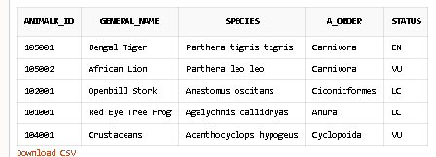
INSERT INTO animal_kind VALUES (103001, 'Lined Seahorse', 'Hippocampus erectus', 'Syngnathiformes', 'VU’);
INSERT INTO animal_kind VALUES (101003, 'Axolotl', 'Ambystoma mexicanum', 'Urodela', 'CR’);
INSERT INTO animal_kind VALUES (104001, 'Crustaceans', 'Acanthocyclops hypogeus', 'Cyclopoida', 'VU’);

Slide 20
create table animal(
animal_id number primary key, animal_name varchar(100), cage_no number,
height number, weight number, age number,
gender varchar(10), origin varchar(100), animalk_id NUMBER,
FOREIGN KEY (animalk_id) REFERENCES animal_kind(animalk_id),
zoo_id number,
FOREIGN KEY(zoo_id) REFERENCES zoo(zoo_id)
);

Slide 21
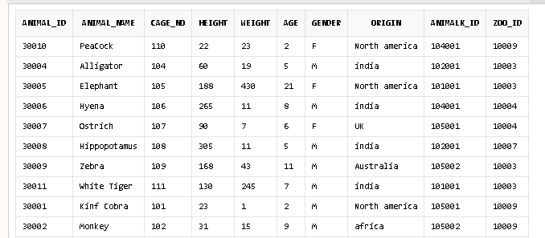
INSERT INTO animal VALUES (30001, ‘King Cobra', 101, 23, 1, 2, 'M', 'North america', 105001, 10009);
INSERT INTO animal VALUES (30002, 'Monkey', 102, 31, 15, 9, 'M', 'africa', 105002, 10009);
INSERT INTO animal VALUES (30004, 'Alligator', 104, 60, 19, 5, 'M ', 'india', 102001, 10003);
INSERT INTO animal VALUES (30005, 'Elephant', 105, 188, 430, 21, 'F', 'North america', 101001, 10003);
INSERT INTO animal VALUES (30006, 'Hyena', 106, 265, 11, 8, 'M', 'india', 104001, 10004);
INSERT INTO animal VALUES (30007, 'Ostrich', 107, 90, 7, 6, 'F', 'UK', 105001, 10004);
INSERT INTO animal VALUES (30008, 'Hippopotamus', 108, 305, 11, 5, 'M', 'india', 102001, 10007);
INSERT INTO animal VALUES (30009, 'Zebra', 109, 168, 43, 11, 'M', 'Australia', 105002, 10003);
INSERT INTO animal VALUES (30010, 'PeaCock', 110, 22, 23, 2, 'F', 'North america', 104001, 10009);
INSERT INTO animal VALUES (30011, 'White Tiger', 111, 130, 245, 7, 'M', 'india', 101001, 10003);

Slide 22
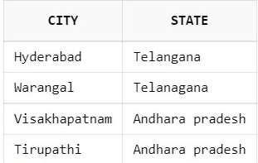
create table location(
city varchar(100) primary key, state varchar(100));
INSERT INTO location VALUES ('Hyderabad', 'Telangana');
INSERT INTO location VALUES ('Warangal', 'Telanagana');
INSERT INTO location VALUES ('Visakhapatnam', 'Andharapradesh'); INSERT INTO location VALUES ('Tirupathi', 'Andhara pradesh');

Slide 23
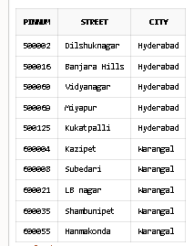
create table pincode( pinnum number primary key, street varchar(100),
city varchar(100),
FOREIGN KEY (city) REFERENCES location(city));
INSERT INTO PINCODE VALUES (500002, 'DILSHUKNAGAR', 'HYDERABAD’); INSERT INTO PINCODE VALUES (500016, 'BANJARA HILLS', 'HYDERABAD’); INSERT INTO PINCODE VALUES (500060, 'VIDYANAGAR', 'HYDERABAD’); INSERT INTO PINCODE VALUES (500069, 'MIYAPUR', 'HYDERABAD’); INSERT INTO PINCODE VALUES (500125, 'KUKATPALLI', 'HYDERABAD’); INSERT INTO PINCODE VALUES (600004, 'KAZIPET', 'WARANGAL’);
INSERT INTO PINCODE VALUES (600008, 'SUBEDARI', 'WARANGAL’); INSERT INTO PINCODE VALUES (600021, 'LB NAGAR', 'WARANGAL’); INSERT INTO PINCODE VALUES (600035, 'SHAMBUNIPET', 'WARANGAL’); INSERT INTO PINCODE VALUES (600055, 'HANMAKONDA', 'WARANGAL');

Slide 24
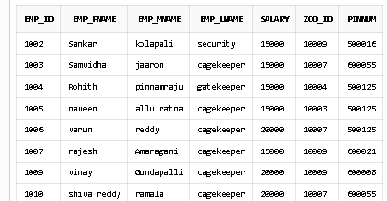
CREATETABLEEMPLOYEE (
EMP_IDNUMBERPRIMARYKEY, EMP_FNAME VARCHAR(100), EMP_MNAME VARCHAR(100), EMP_LNAMEVARCHAR(100), SALARYNUMBER, ZOO_IDNUMBER,
FOREIGNKEY(ZOO_ID)REFERENCESZOO(ZOO_ID), PINNUM NUMBER,
FOREIGNKEY(PINNUM) REFERENCESPINCODE(PINNUM)
);
INSERTINTO EMPLOYEEVALUES(1001, 'RAGHU', 'PHANESH', 'SANITARY', 60000, 10004, 500001); INSERT
INTOEMPLOYEEVALUES(1002, 'SANKAR', 'KOLAPALI', 'SECURITY', 15000, 10009,500016); INSERTINTO
EMPLOYEEVALUES(1003, 'SAMVIDHA', 'JAARON','CAGEKEEPER',15000, 10007, 600055);
INSERTINTOEMPLOYEEVALUES(1004, 'ROHITH', 'PINNAMRAJU', 'GATEKEEPER',15000, 10004, 500125);
INSERTINTOEMPLOYEEVALUES(1005, 'NAVEEN', 'ALLU RATNA', 'CAGEKEEPER',15000, 10003, 500125);
INSERTINTOEMPLOYEEVALUES(1006, 'VARUN', 'REDDY', 'CAGEKEEPER',20000, 10007, 500125);
INSERTINTOEMPLOYEEVALUES(1007, 'RAJESH','AMARAGANI', 'CAGEKEEPER',15000, 10009, 600021);
INSERT INTO EMPLOYEE VALUES (1008, 'WASEEM', 'AGARWAL', 'CAGEKEEPER', 15000, 10003, 500001);
INSERT INTO EMPLOYEE VALUES (1009, 'VINAY ', 'GUNDAPALLI', 'CAGEKEEPER', 20000, 10009, 600008);
INSERTINTOEMPLOYEEVALUES(1010, 'SHIVAREDDY','RAMALA', 'CAGEKEEPER',20000, 10007, 600055);

Slide 25
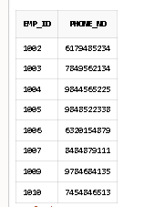
create table contact( emp_id number,
FOREIGN KEY (emp_id) REFERENCES employee(emp_id), number);
INSERT INTO contact VALUES (1001, 8741122565);
INSERT INTO contact VALUES (1002, 6179485234);
INSERT INTO contact VALUES (1003, 7849562134);
INSERT INTO contact VALUES (1004, 9844565225);
INSERT INTO contact VALUES (1005, 9848522338);
INSERT INTO contact VALUES (1006, 6320154879);
INSERT INTO contact VALUES (1007, 8484879111);
INSERT INTO contact VALUES (1008, 9787488845);
INSERT INTO contact VALUES (1009, 9784684135);
INSERT INTO contact VALUES (1010, 7454846513);

Slide 26
create table visitor( v_id number PRIMARY KEY, phone_no number,
pinnum number, foreign key (pinnum) references pincode(pinnum), v_fname varchar(100),
v_lname varchar(100)
);
INSERT INTO visitor VALUES (1000002, 8247423616, 500001, 'Sandhya', 'Dhanavath’);
INSERT INTO visitor VALUES (1000003, 9848522338, 500002, 'Shankar', 'Tejavath’); INSERT INTO visitor VALUES (1000004, 7532148967, 500060, 'Waseem', 'Syed’ ); INSERT INTO visitor VALUES (1000005, 6459783120, 500125, 'Manoj', 'Boganadham’);
INSERT INTO visitor VALUES (1000006, 8524615397, 500069, 'Infi', 'Chan’);
INSERT INTO visitor VALUES (1000007, 9754125896, 600004, 'Bhushank', 'Kul’);
INSERT INTO visitor VALUES (1000008, 8462157930, 600055, 'Abhiram', 'Nallama’);
INSERT INTO visitor VALUES (1000009, 6841759325, 600008, 'Ashish', 'Anand’);
INSERT INTO visitor VALUES (1000010, 8945632178, 600154, 'Lakshita', 'Chowdary’);
INSERT INTO visitor VALUES (1000011, 9685741232, 600035, 'Nayan', 'Jyothi’);
INSERT INTO visitor VALUES (1000012, 8675941236, 600021, 'Ranil', 'Bala’);
INSERT INTO visitor VALUES (1000013, 7849562134, 600154, 'Tanisha', 'Agarwal');

Slide 27
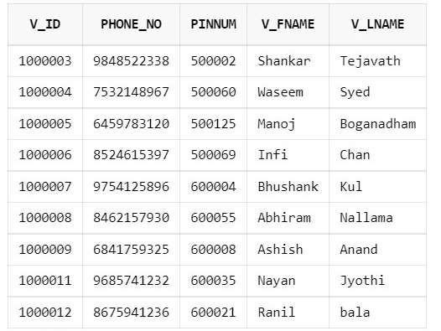

Slide 28
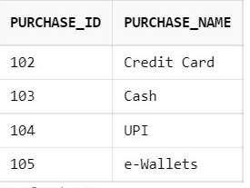
create table purchase( purchase_id number primary key, varchar(100));
insert into purchase values(102,'Credit Card'); insert into purchase values(103,'Cash');
insert into purchase values(104,'UPI');
insert into purchase values(105,'e-wallets');

Slide 29
create table ticket(
ticket_id number primary key, ticket_date date,
v_id number,
FOREIGN KEY (v_id) REFERENCES visitor(v_id), purchase_id number,
FOREIGN KEY (purchase_id) REFERENCES purchase(purchase_id),
zoo_id number, FOREIGN KEY (zoo_id) REFERENCES zoo(zoo_id));
INSERT INTO ticket VALUES (9034351, '15-08-2020', 1000002, 104, 10004);
INSERT INTO ticket VALUES (2110003, '15-02-2020', 1000003, 104, 10007);I
NSERT INTO ticket VALUES (6382682, '15-02-2020', 1000004, 103, 10003);I
NSERT INTO ticket VALUES (6824217, '14-02-2020', 1000005, 102, 10007);
INSERT INTO ticket VALUES (5193139, '15-02-2020', 1000006, 103, 10009);
INSERT INTO ticket VALUES (5542291, '14-02-2020', 1000007, 102, 10003);
INSERT INTO ticket VALUES (2580752, '14-02-2020', 1000008, 104, 10007);
INSERT INTO ticket VALUES (9154961, '15-02-2020', 1000009, 102, 10007);
INSERT INTO ticket VALUES (8391607, '14-02-2020', 1000010, 101, 10007);
INSERT INTO ticket VALUES (1329791, '14-02-2020', 1000011, 102, 10007);

Slide 30
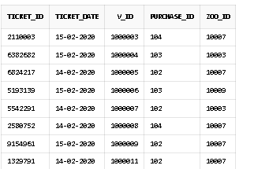

Slide 31
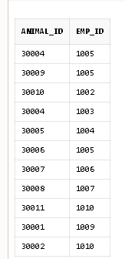
create table looks_after(
animal_id number,
FOREIGN kEY (animal_id) REFERENCES animal(animal_id), FOREIGN KEY (emp_id) REFERENCES employee(emp_id));
INSERT INTO looks_after(animal_id, emp_id) VALUES (30010, 1002); INSERT INTO looks_after(animal_id, emp_id) VALUES (30004, 1003); INSERT INTO looks_after(animal_id, emp_id) VALUES (30005, 1004); INSERT INTO looks_after(animal_id, emp_id) VALUES (30006, 1005); INSERT INTO looks_after(animal_id, emp_id) VALUES (30007, 1006); INSERT INTO looks_after(animal_id, emp_id) VALUES (30008, 1007); INSERT INTO looks_after(animal_id, emp_id) VALUES (30009, 1000); INSERT INTO looks_after(animal_id, emp_id) VALUES (30011, 1010); INSERT INTO looks_after(animal_id, emp_id) VALUES (30001, 1009); INSERT INTO looks_after(animal_id, emp_id) VALUES (30002, 1010);

Slide 32
create table visits(
ticket_id number PRIMARY KEY,
FOREIGN KEY (ticket_id) REFERENCES ticket(ticket_id), in_time TIMESTAMP,
out_time TIMESTAMP);
INSERT INTO visits VALUES (1329791, to_timestamp('16/02/2020 10:53:10', 'dd/mm/yyyy HH24:MI:SS'),to_timestamp( '16/02/2020 16:53:15','dd/mm/yyyy HH24:MI:SS'));INSERT INTO visits VALUES (9154961, to_timestamp('2020-02-16 10:53:45','yyyy/mm/dd HH24:MI:SS'), to_timestamp('2020-02-16 16:07:41','yyyy/mm/dd HH24:MI:SS'));INSERT INTO visits VALUES (5542291, TO_TIMESTAMP('2020/02/16 10:45:55','yyyy/mm/dd HH24:MI:SS'), TO_TIMESTAMP('2020/02/16 16:05:09','yyyy/mm/dd HH24:MI:SS'));INSERT INTO visits VALUES (5193139, TO_TIMESTAMP('2020/02/16 10:57:30','yyyy/mm/dd HH24:MI:SS'), TO_TIMESTAMP('2020/02/16 16:07:11','yyyy/mm/dd HH24:MI:SS'));INSERT INTO visits VALUES (6824217, TO_TIMESTAMP('2020/02/16 10:59:37','yyyy/mm/dd HH24:MI:SS'), TO_TIMESTAMP('2020/02/16 16:49:04','yyyy/mm/dd HH24:MI:SS'));INSERT INTO visits VALUES (2110003, TO_TIMESTAMP('2020/02/16 10:35:55','yyyy/mm/dd HH24:MI:SS'), TO_TIMESTAMP('2020/02/16 16:39:35','yyyy/mm/dd HH24:MI:SS'));INSERT INTO visits VALUES (6382682, TO_TIMESTAMP('2020/02/16 10:19:33','yyyy/mm/dd HH24:MI:SS'), TO_TIMESTAMP('2020/02/16 16:37:00','yyyy/mm/dd HH24:MI:SS'));

Slide 33
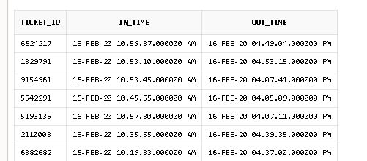

Slide 34
“
Thank You
”

